Slide 1
Fundamentals of Microsoft Teams
Teams application packaging and testing

Slide 2

Teams application packaging and testing
Teams-extensibility options
What is a Teams App?
Why create a Teams App?
How to create a Teams App
Demo

Slide 3
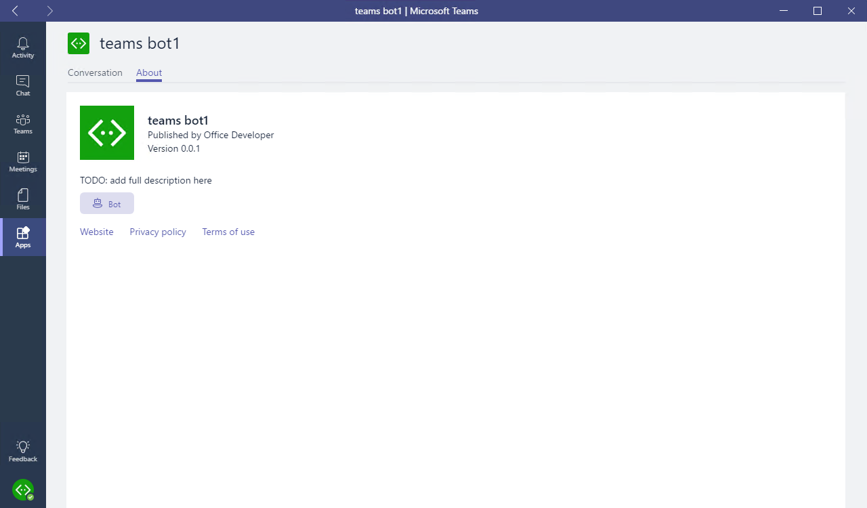
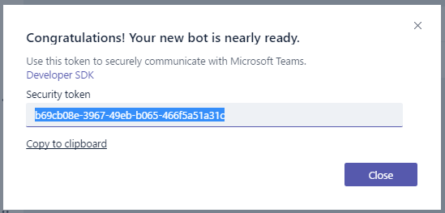
Teams-extensibility options
Microsoft Teams App
Tabs
Bots
Compose extensions
Connectors
Custom Bot
Receive & reply to messages
Notes:
For the best and most extensible option for adding your service into Teams, create a Microsoft Teams app. A Microsoft Teams app is a package of services that you host, that can be distributed through the Teams product or sideloaded by teams.
For quick one-off integration of your existing webhook, you can take advantage of our Custom Bot feature. This ad-hoc extensibility option allows you to simply set up webhooks / notifications in a specific team, with no additional coding required.

Slide 4
What is a Teams App?
Package of services available to users in the contexts (or “scopes”) that make the most sense.
Services
Tabs
Bots
Compose extensions
Connectors
Scopes
Personal (App bar)
Team (Channel)
Package (deployment)
Sideload (one Team)
Office Store
Notes:
Apps in Microsoft Teams allow you to make your service available to users in the contexts - or "scopes" - that make the most sense.
You declare precisely which capabilities you support, in which scopes, via your app package's manifest file.
You can use most app capabilities (such as bots, tabs, etc) in most scopes.
You offer these capabilities via a single Teams app package that users can acquire through our in-product app gallery, via the Office Store, or sideloaded directly by your team.

Slide 5






Why create a Teams App?
Immersive experience
The platform places content and conversations side by side.
Tabs and conversations
Tabs give your app a dedicated canvas that allows people to jump between conversations and your experience.
Customizable cards
Cards let you surface important tasks, information, and reminders in actionable ways.
Bot framework
The Bot framework offers a natural language UX that can interact with your services.
Instant notifications
The activity feed displays notifications for your users.
Compose extensions
Compose Extensions are quick and easy shortcuts to key components of your service.
Notes:
This information comes from the Microsoft Teams Design Guidelines: http://msteamsdesignguidelines.azurewebsites.net/#!/
All of these capabilities are possible in an app, not in a custom bot.
Not all are required. Only publish those that make sense, or start with one and build out over time.

Slide 6
Demo Create and test a basic Teams App using Yeoman
Notes:
Generated project:
Review folders: src, manifest, package
Review gulp tasks: manifest, build, serve
Source files:
*.html files: “inject” comments
Used to inject TypeScript compiled output into page
Net result is HTML/JavaScript in same page
Every page needs “microsoftTeams.initialize()”, and is called in TypeScript object constructor
webpack.config.js defines “output / library” around line 61. This library name is a namespace, used to qualify TypeScript objects

Slide 7

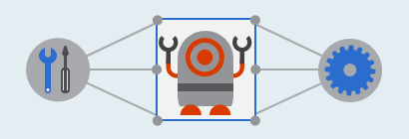

How to create a Teams App
Develop components
HTML
TypeScript / JavaScript
.NET
Integrate with Teams
Microsoft Teams JavaScript Library
Bot Builder SDK - Node.js & C#
Package and deploy
Host web pages and services
Create and package manifest
Sideload/publish package

Slide 8

Summary

Slide 9
Thank you

